Slide 1


MedCLIP : Contrastive Learning from Unpaired Medical Images and Text Zifeng Wang, Zhenbang Wu, Dinesh Agarwal, Jimeng Sun
Medical Imaging & Intelligent Reality Lab.
Convergence Medicine/Radiology,
University of Ulsan College of Medicine
Asan Medical Center
Jihoon Jung
2023.03.16
www.mi2rl.co

Slide 2
Abtract
Existing vision-text contrastive learning like CLIP (Radford et al., 2021) aims to match the paired image and caption embeddings while pushing others apart.
Previous method limitation in medical domain
medical image-text datasets are orders of magnitude below the general images and captions from the internet.
previous methods encounter many false negatives, i.e., images and reports from separate patients probably carry the same semantics but are wrongly treated as negatives.
Novelty
we decouple images and texts for multimodal contrastive learning.
We also propose to replace the InfoNCE loss with semantic matching loss based on medical knowledge to eliminate false negatives in contrastive learning.

Slide 3
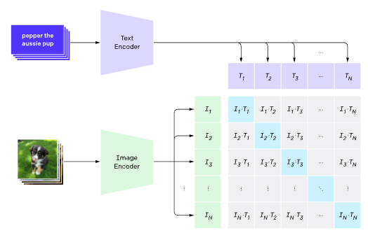
Introduction
The issues with adopting the CLIP model for the medical domain.
CLIP’s (Radford et al., 2021) data-hungry nature : CLIP is trained on a dataset of 400M image-text pairs collected from the internet
Specificity of medical images and reports: compared to general domains : the differences within medical domains are more subtle and fine-grained

Slide 4
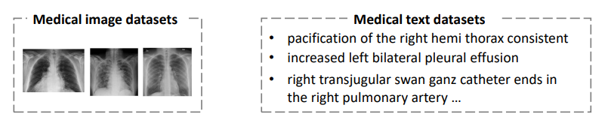
Introduction
Challenges
Limited usable data :
Most medical image datasets only provide the diagnostic labels instead of the raw reports.
However, Previous methods need paired image and reports, leaving a vast number of medical image-only and text-only datasets unused.

Slide 5
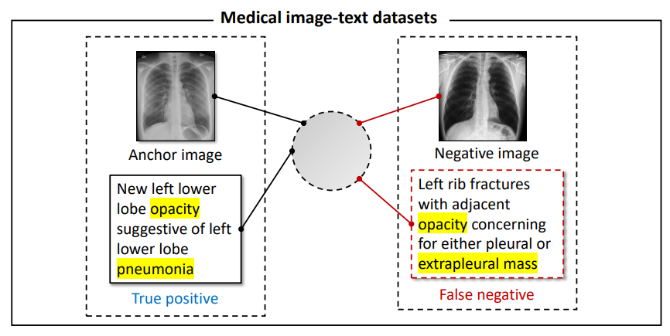
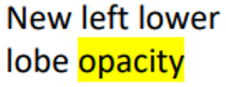
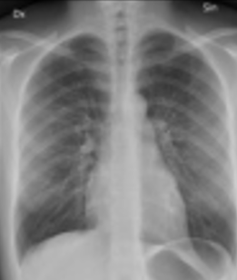
Introduction
Challenges
False negatives in contrastive learning :
Previous methods try to push images and texts embeddings from different patients apart.
However, even though some reports do not belong to the target patient’s study, they can still describe the same symptoms and findings.
Simply treating the other reports as negative samples brings noise to the supervision and confuses the model.

Slide 6
Introduction
Contribution
Decoupling images and texts for contrastive learning :
We extend the pre-training to cover the massive unpaired images and texts datasets, which scales the number of training data in a combinatorial manner.
It opens a new direction to expand multi-modal learning based on medical knowledge.
Eliminating false negatives via medical knowledge.
We observe that images and reports from separate patients’ studies may carry the same semantics but are falsely treated as negatives by previous methods.
Hence, we design a soft semantic matching loss that uses the medical semantic similarity between each image and report as the supervision signal.
This approach equips the model with the ability to capture the subtle yet crucial medical meanings.

Slide 7
Introduction
Contribution
Decoupling images and texts for contrastive learning :
We extend the pre-training to cover the massive unpaired images and texts datasets, which scales the number of training data in a combinatorial manner.
It opens a new direction to expand multi-modal learning based on medical knowledge.
Eliminating false negatives via medical knowledge.
We observe that images and reports from separate patients’ studies may carry the same semantics but are falsely treated as negatives by previous methods.
Hence, we design a soft semantic matching loss that uses the medical semantic similarity between each image and report as the supervision signal.
This approach equips the model with the ability to capture the subtle yet crucial medical meanings.

Slide 8
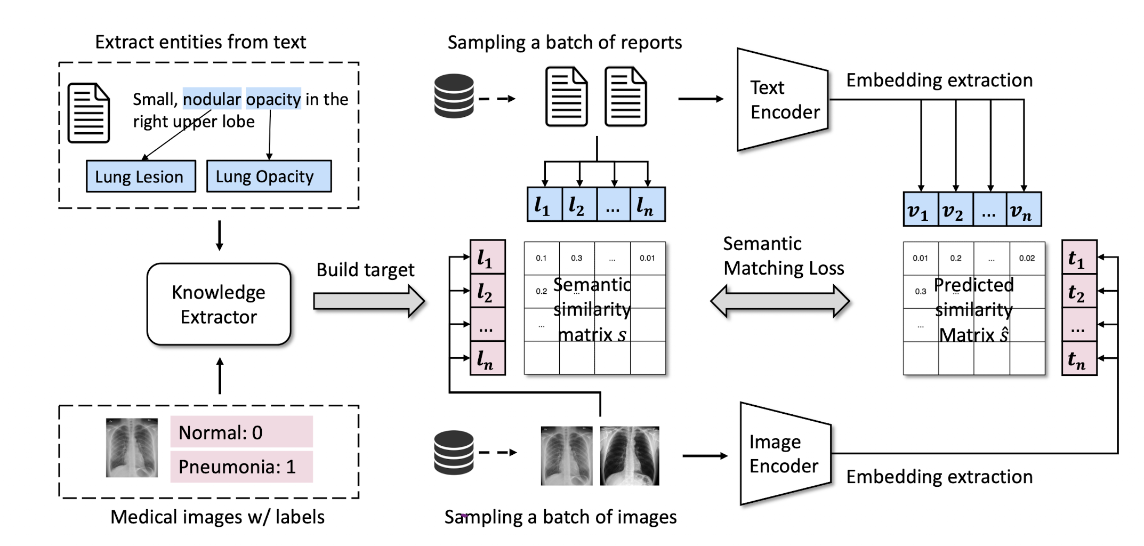
Method
In this section, we present the technical details of MedCLIP following the flow in Fig. 3.
MedCLIP consists of 3 components
vision and text encoders that extracts embeddings
knowledge extraction that builds the semantic similarity matrix
semantic matching loss that trains the whole model.
2
3
1

Slide 9
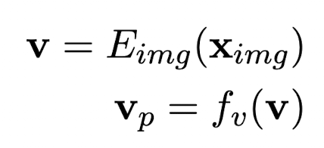
Method
Vision and Text Encoder
MedCLIP consists of one visual encoder and one text encoder.
Vision Encoder.
We encode images into embeddings v ∈ R^{D} using a vision encoder E_{img}.
A projection head then maps raw embeddings to v_{p}∈R^{P}.
where f_{v} is the projection head of the vision encoder.
1
3
2

Slide 10
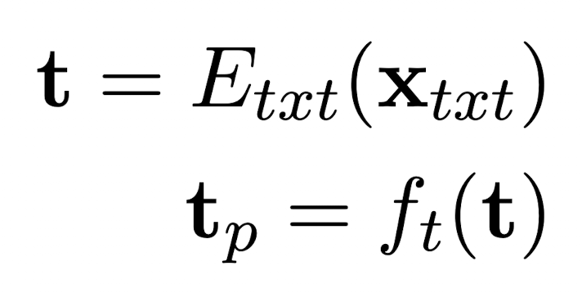
Method
Vision and Text Encoder
MedCLIP consists of one visual encoder and one text encoder.
Text Encoder.
We create clinically meaningful text embeddings t ∈ R^{M} by a text encoder.
We project them to t_{p} ∈R^{P} as
where f_{t} is the projection head and E_{txt} denotes the text encoder.
2
3
1

Slide 11
Method
Decouple Image-Text Pairs with Medical Knowledge Extractor
Paired medical image text datasets are orders of magnitude less than the general paired image text (e.g., from the internet)
To enhance medical multi-modal learning, we want to make the full use of all existing medical image-text, image-only, and text-only datasets.
Suppose we have n paired image-text samples, m labeled images, and h medical sentences. Image sets : n+m text sets : n+h
Knowledge extractor for image-text & text-only data : Use MetaMap with UMLS(Unified Medical Language System) https://gweissman.github.io/post/using-metamap-with-python-to-access-the-umls-metathesaurus-a-quick-start-guide/
Knowledge extractor for only-image data (w / labels) : Match 14 keywords to label
We build multi-hot vectors from the extracted entities for images and texts, as l_{img} and l_{txt}, respectively.

Slide 12
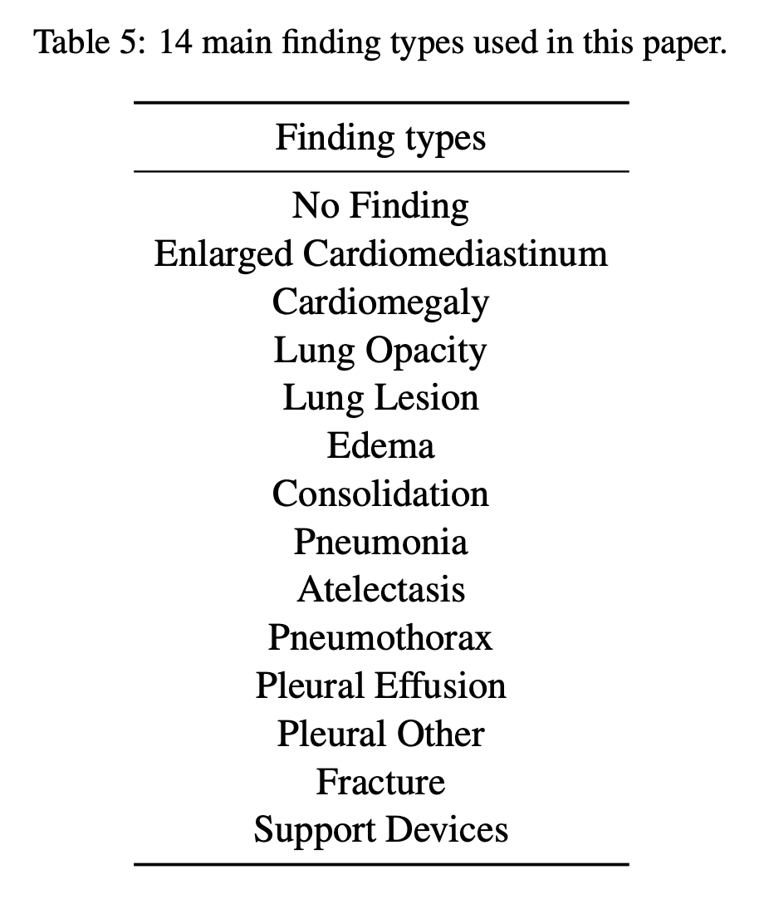
Method

Slide 13
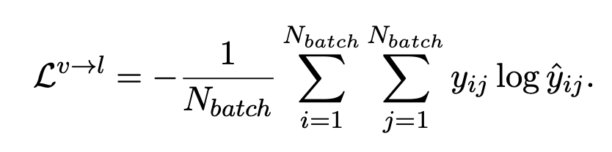
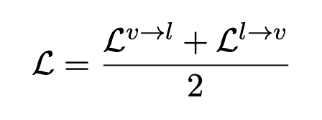
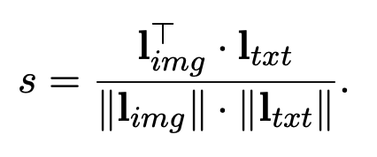
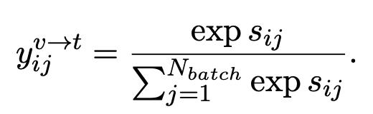
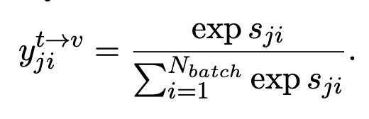
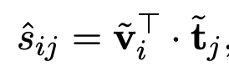
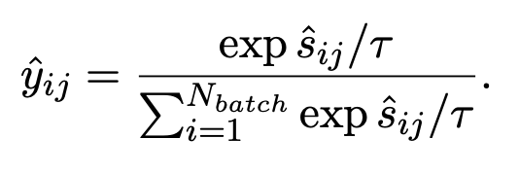
Method
Semantic Matching Loss

Slide 14
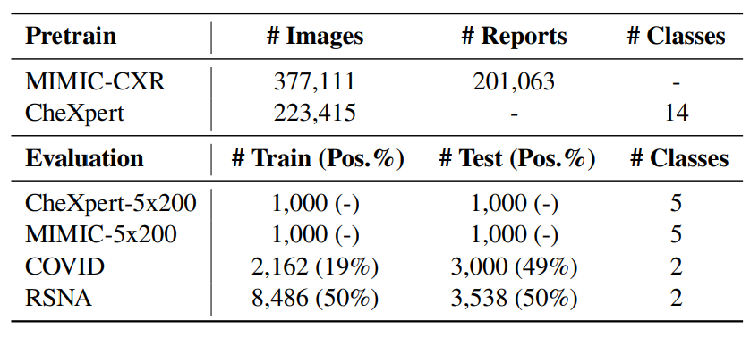
Dataset

Slide 15
Experiments
Implementation details
MedCLIP text encoder : BioClinicalBERT
MedCLIP image encoder : Swin-transformer
MedCLIP encoder output dimension : 512
MIMIC CXR : combine the “Findings” and “Impression” sections of reports then split them into sentences.

Slide 16
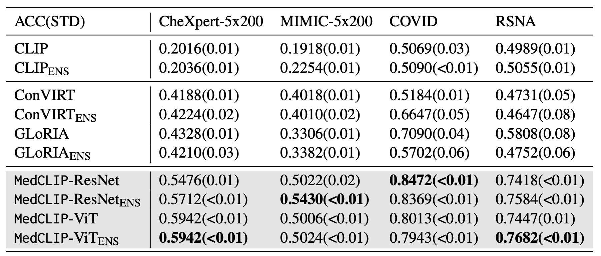
Experiments
Zero-shot classification
Baseline models use traditional contrastive learning. So, they generate false negatives, which aggravate ensemble model
Interestingly, MedCLIP yields over 0.8 ACC on COVID data while there is no COVID-19 positive image available during the course of pre-training.
This result demonstrates that contrastive pre-training of MedCLIP provides it with the transferability to out-of-domain classes.

Slide 17
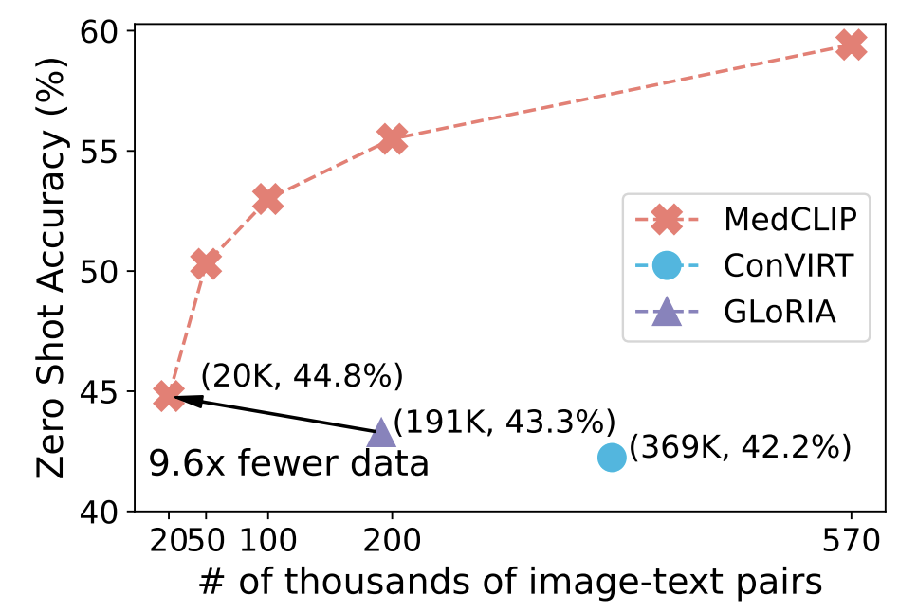
Experiments
Pre-training Data Efficiency

Slide 18
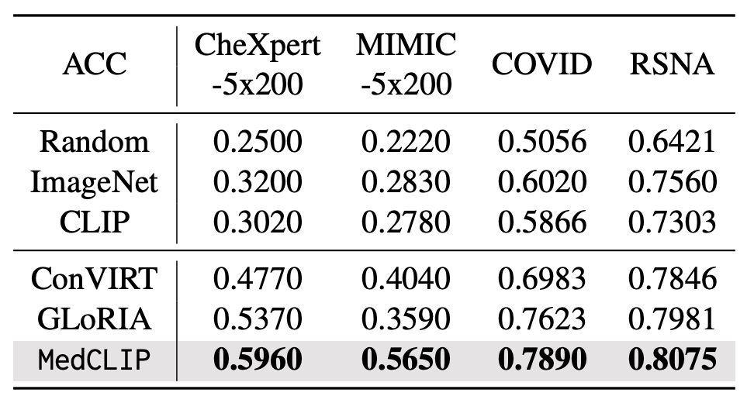
Experiments
Fine-tune for Classification
we surprisingly find that MedCLIP makes zero-shot prediction comparable with supervised learning models when contrasting Table 2 to Table 1.
< Supervised manner >
< Unsupervised manner >

Slide 19
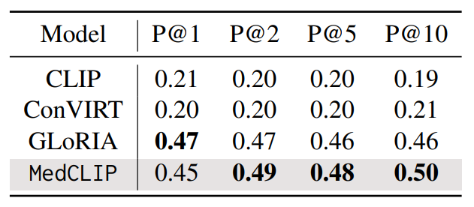
Experiments
Image-Text Retrieval : We choose CheXpert-5x200 to evaluate the semantic richness of the learned representations. CheXpert-5x200 do not have report data publicly available, we used MIMIC-CXR dataset to come up with reports/sentences. We sampled 200 sentences for each of the 5 classes as present in CheXpert5x200 dataset.

Slide 20
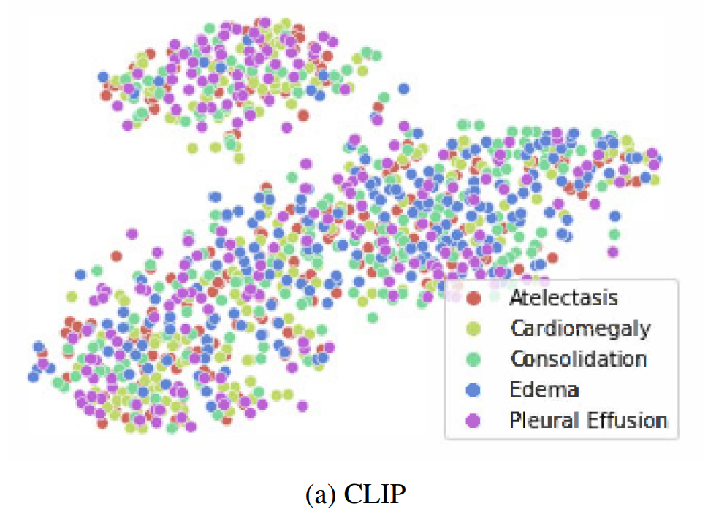
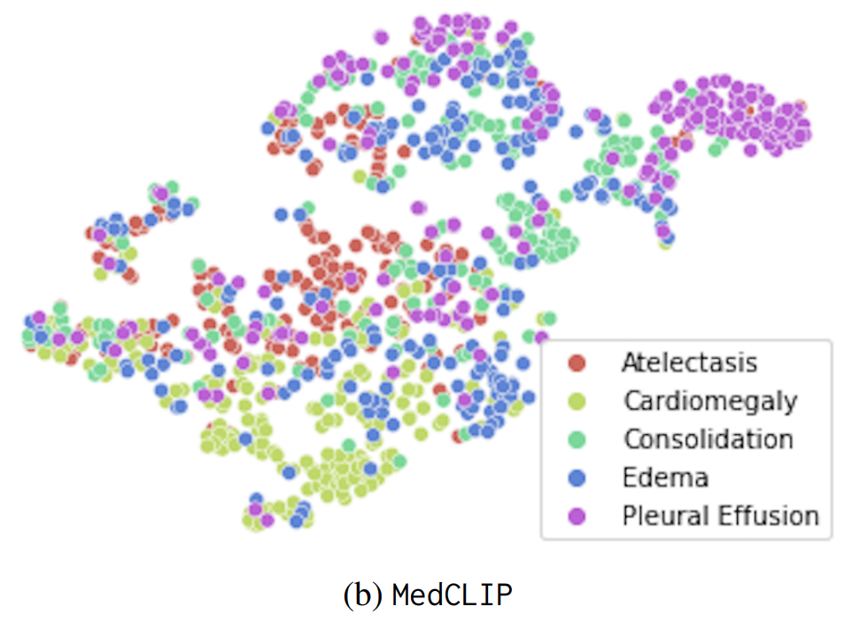
Experiments
Embedding Visualization

Slide 21


Collaborators
Cardiac
June-goo Lee
Gyu-jun Jeong
Tae-won Kim
Ji-hoon Jung
Pathology
Hyunjeong Go, Gyuheon Choi
Gyungyub Gong, Dong Eun Song
Cardiology
Jaekwan Song, Jongmin Song
Young-Hak Kim
Anesthesiology
Sung-Hoon Kim, Eun Ho Lee
Neurology
Dong-Wha Kang, Chongsik Lee
Jaehong Lee, Sangbeom Jun
Misun Kwon, Beomjun Kim, Sun Kwon, Eun-Jae Lee
Surgery
Beom Seok Ko, JongHun Jeong
Songchuk Kim, Tae-Yon Sung
Gastroenterology
Jeongsik Byeon, Kang Mo Kim, Do-hoon Kim
Emergency Medicine
Dong-Woo Seo
Pulmonology and Critical Care Medicine
Yoen-mok Oh, Sei Won Lee, Jin-won Huh

